Slide 1

PYTHON COMMENTS

Slide 2
PYTHON COMMENTS
Comments can be used to explain Python code. Comments can be used to make the code more readable.
Comments can be used to prevent execution when testing code.

Slide 3

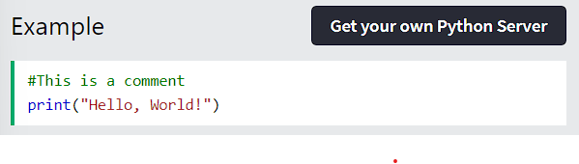

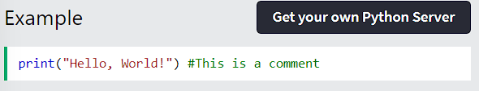
CREATING A COMMENT
Comments starts with a #, and Python will ignore them:
Comments can be placed at the end of a line, and Python will ignore the rest of the line:

Slide 4

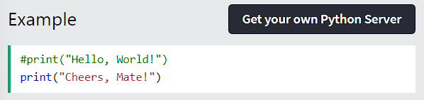
CREATING A COMMENT
A comment does not have to be text that explains the code, it can also be used to prevent Python from executing code:

Slide 5

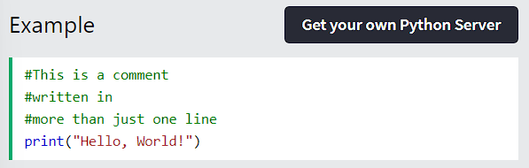
MULTILINE COMMENT
Python does not really have a syntax for multiline comments. To add a multiline comment you could insert a # for each line:

Slide 6

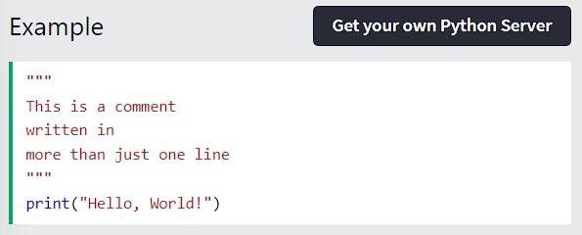
MULTILINES COMMENT
Or, not quite as intended, you can use a multiline string.
Since Python will ignore string literals that are not assigned to a variable, you can add a multiline string (triple quotes) in your code, and place your comment inside it:
As long as the string is not assigned to a variable, Python will read the code, but then ignore it, and you have made a multiline comment.

Slide 7
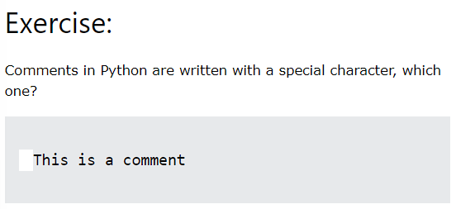
TEST YOURSELF WITH EXERCISES

Slide 8
THANK YOU

